Slide 1

Bank Loan Case Study
Shreya Gunjal

Slide 2

Project description
This project involves a dataset from a bank for calculating risky loan applications and deciding which applicants are more trustworthy than others. The bank is dealing with an issue: some customers with limited credit histories are defaulting on their loans. When a customer applies for a loan, the company faces two key risks:
If a qualified applicant is denied, the company misses out on potential business.
If an unqualified applicant is approved and cannot repay the loan, the company incurs a financial loss.
The dataset analyzed contains information about loan applications, specifically in two scenarios:
Customers with repayment issues: These individuals were late by more than X days on at least one of the first Y installments.
All other cases: These represent customers who made their payments on time.
Using Exploratory Data Analysis (EDA) analyze patterns in the data and gain insights so that capable applicants are not rejected.

Slide 3





APPROACH
Step 1
Step 2
Step 3
Step 4
Step 5
Understanding the various columns in the data.
Dealing with data by cleaning, fixing null values.
Identifying outliers, creating new columns for ease.
Making pivot tables, charts, formulas to visualize information needed
Gaining valuable insights from the data

Slide 4


TECH STACK USED
MICROSOFT EXCEL 365
MICROSOFT POWERPOINT
Following is the link for excel sheet : https://docs.google.com/spreadsheets/d/1DKF9i6ugUGzGf1j7QFLOIiiXUhaqyND9/edit?usp=sharing&ouid=110446323541757318313&rtpof=true&sd=true

Slide 5
A. Identify AND Deal with Missing Data
As a data analyst, you come across missing data in the loan application dataset. It is essential to handle missing data effectively to ensure the accuracy of the analysis.
Task: Identify the missing data in the dataset and decide on an appropriate method to deal with it using Excel built-in functions and features.

Slide 6
Columns with >40% null values were deleted to avoid skewed data. Other unimportant columns were also deleted.

Slide 7
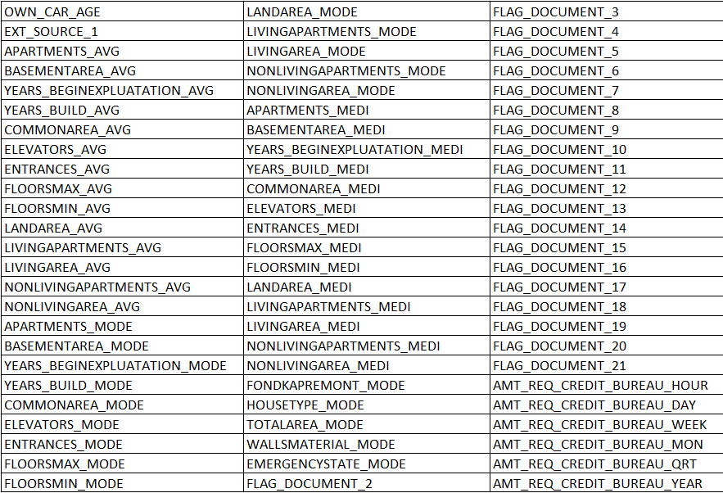
Dropped columns:
All columns that had no. of days in them were also in negative values. They were converted to positive values. In reference to these columns, new columns were added representing days with years.
New columns like no. of parents, concat (income type + family) Years employed, FLAG IF EMP>AGE, registered for years, FLAG IF REG>AGE, id publish years ,concat income + edu, CREDIT:INC, ANNUITY:INC, ANNUITY:CREDIT and CREDIT:GOODS. This was done to effectively calculate missing values in some columns as well as deal with outliers.

Slide 8
Missing values for AMT_GOODS_PRICE were filled with the corresponding rows’ values for AMT_CREDIT
Missing values in CNT_FAM_MEMBERS were replaced with mode value 2. All values with ‘XNA’ in CODE_GENDER were replaced with ‘F’ as most values were ‘F’. Median values were used to fill null data in other numerical columns which didn’t include amount of money or a period of time.
All values with ‘XNA’ in ORGANIZATION_TYPE have pensioners and unemployed people in NAME_INCOME_TYPE and therefore were replaced with “Unemployed”.
Missing value in AMT_ANNUITY was replaced with median value of AMT_ANNUITY for the corresponding values from AMT_INCOME and AMT_CREDIT columns.
For missing values in OCCUPATION_TYPE, ‘concat income + edu’ column was evaluated corresponding to null values in OCCUPATION_TYPE. Then, the most commonly occurring OCCUPATION_TYPE for each ‘concat income + edu’ value was used to fill the null values in OCCUPATION_TYPE.
One ‘Unknown’ value in NAME_FAMILY_STATUS column was replaced with ‘Married’ considering the row’s values in CNT_CHILDREN, CNT_FAM_MEMBERS, no. of parents in family and NAME_HOUSING_TYPE

Slide 9
B. Identify Outliers in the Dataset
Outliers can significantly impact the analysis and distort the results. You need to identify outliers in the loan application dataset.
Task: Detect and identify outliers in the dataset using Excel statistical functions and features, focusing on numerical variables.

Slide 10
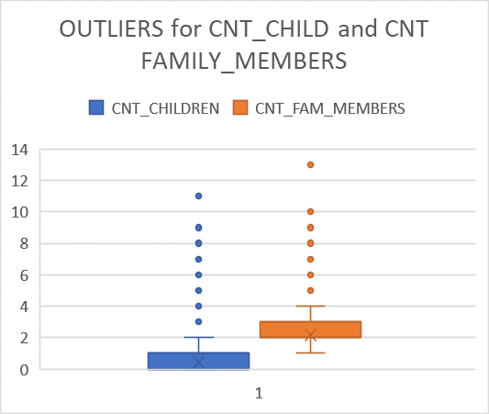
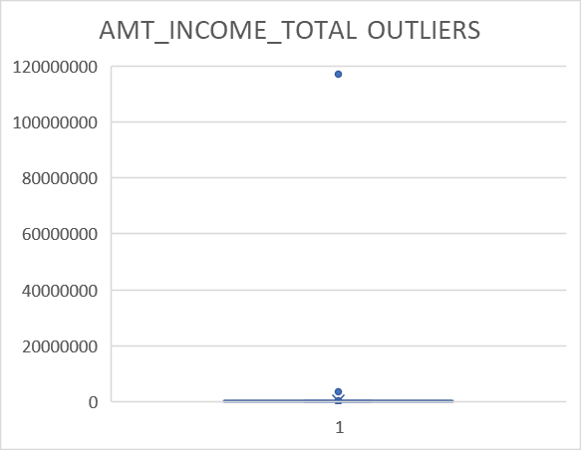
The outliers fir CNT_CHILDREN column show one of the values as ‘11’. Even though this number is too high, the outliers in CNT_FAM_MEMBERS show the outliers suggesting ‘13’ family members in a family which means it was a correct entry. A new column called ‘no. of parents’ was made to see if any value was ‘1’ or ‘2’. No cases were seen therefore outliers were kept as it is.
In the outliers plot for AMT_INCOME_TOTAL OUTLIERS, values over 4000000 were taken as outliers. There was one value 117000000 which was too high and therefore replaced with median value 145800.

Slide 11
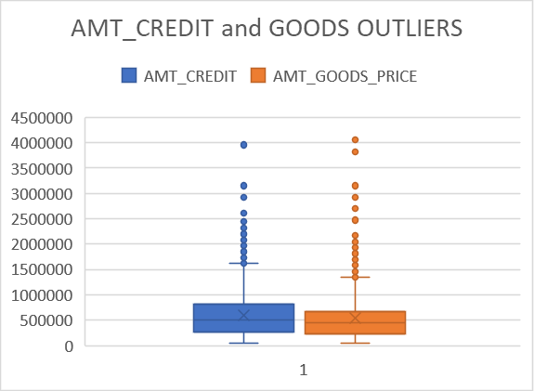
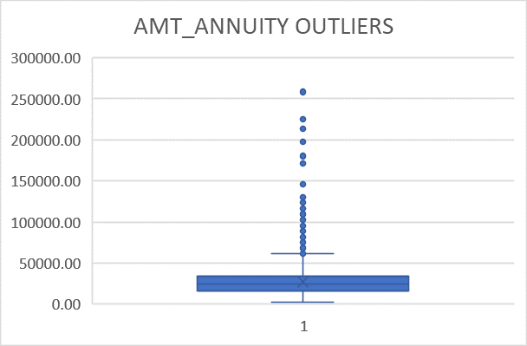
Both plots for AMT_CREDIT and AMT_GOODS_PRICE had outliers. To deal with this, new columns were made to look at the ratio between credit and income (CREDIT:INC) and credit and goods price (CREDIT:GOODS).
Plot for AMT_ANNUITY had outliers. To deal with this, new columns were made to look at the ratio between annuity and income (ANNUITY:INC) and annuity and credit (ANNUITY:CREDIT).

Slide 12
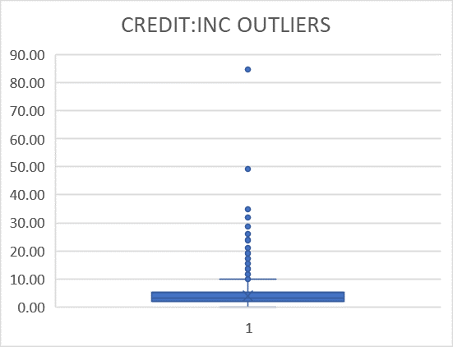
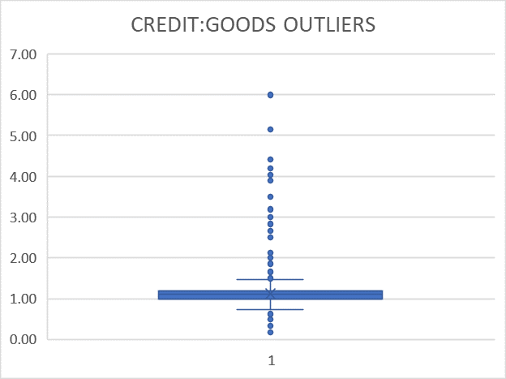
Any values in CREDIT:INC higher than 20 were looked into. Those that were unemployed and pensioners were removed from the list
Any values in CREDIT:INC higher than 2 were looked into. These values of credit were replaced with their respective goods prices.

Slide 13
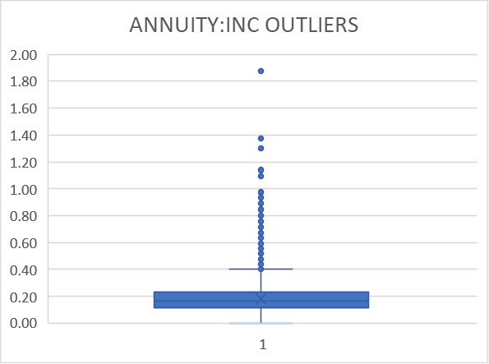
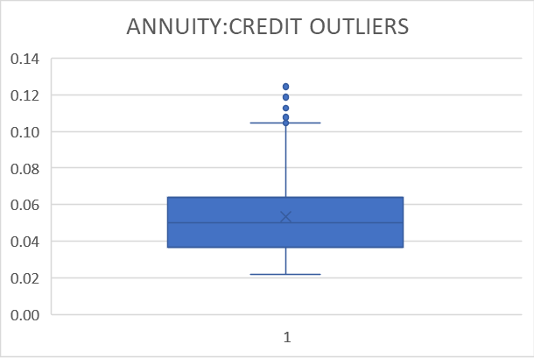
Any values in ANNUITY:INC higher than 0.65 were looked into as annuity amounts higher than that would prove to be difficult to repay. Those that were unemployed and pensioners were removed from the list
No changes were made as the values were smaller.

Slide 14
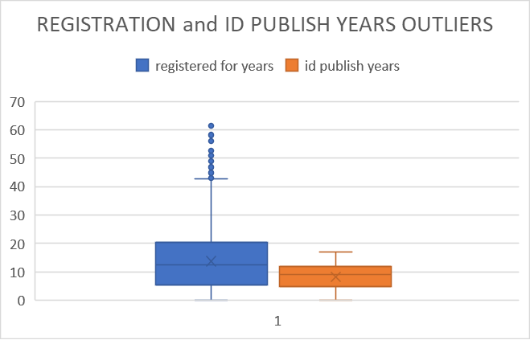
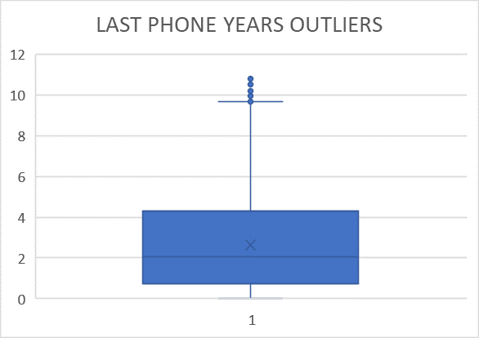
No values removed as all values were less that Age of applicant.
No values removed as the highest value was around 10

Slide 15
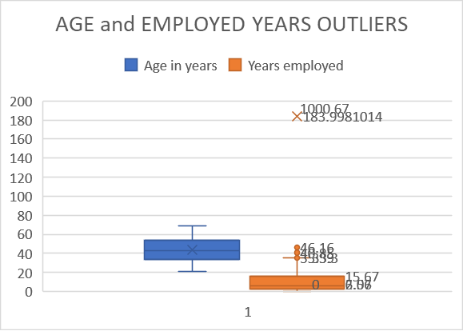
No outliers were seen in Age in years plot. However, the Years employed column had an outlier of 1000.67 years. These were replaced with median value 6.07
Finally, 49937 rows and 61 columns of data remained.

Slide 16
C. Analyze Data Imbalance
Data imbalance can affect the accuracy of the analysis, especially for binary classification problems. Understanding the data distribution is crucial for building reliable models.
Task: Determine if there is data imbalance in the loan application dataset and calculate the ratio of data imbalance using Excel functions.

Slide 17
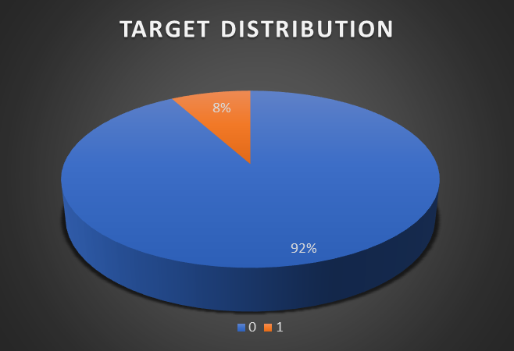
The number of applicants with no payment difficulties significantly outnumbers the applicants with payment difficulties. within a dataset. This imbalance can lead to challenges in classification problems and studying reasons for payment difficulties.

Slide 18
D. Perform Univariate, Segmented Univariate, and Bivariate Analysis
To gain insights into the driving factors of loan default, it is important to conduct various analyses on consumer and loan attributes.
Task: Perform univariate analysis to understand the distribution of individual variables, segmented univariate analysis to compare variable distributions for different scenarios, and bivariate analysis to explore relationships between variables and the target variable using Excel functions and features.

Slide 19
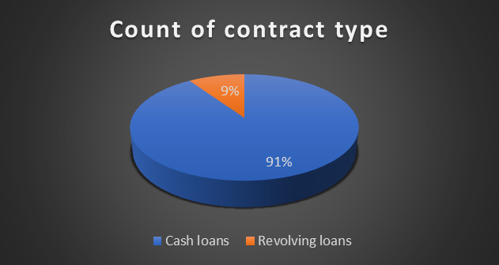
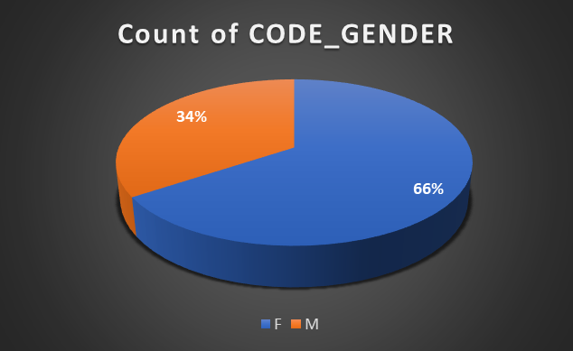
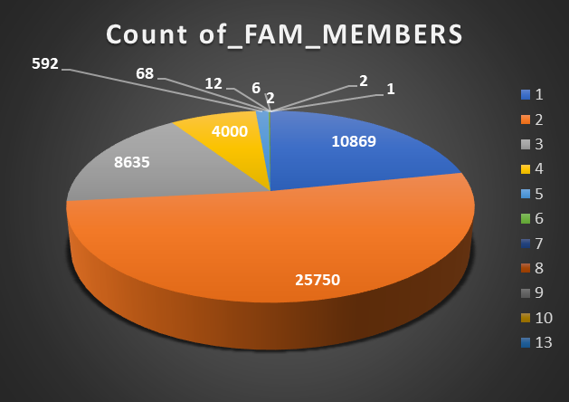
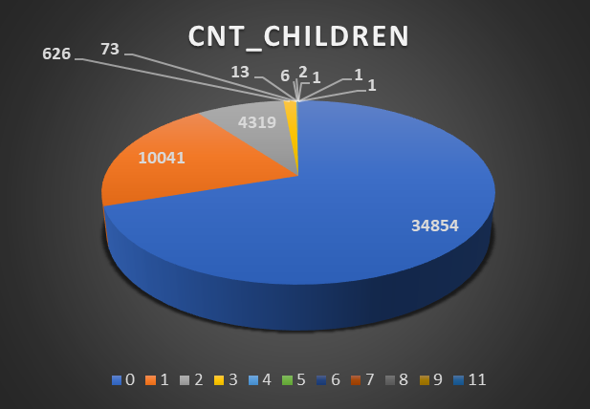
UNIVARIATE ANALYSIS

Slide 20
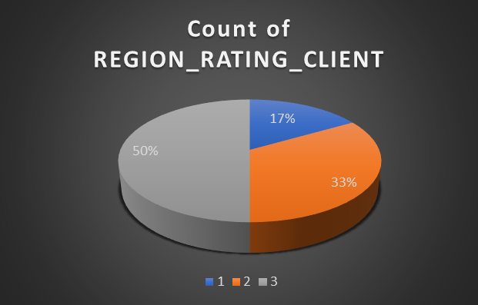
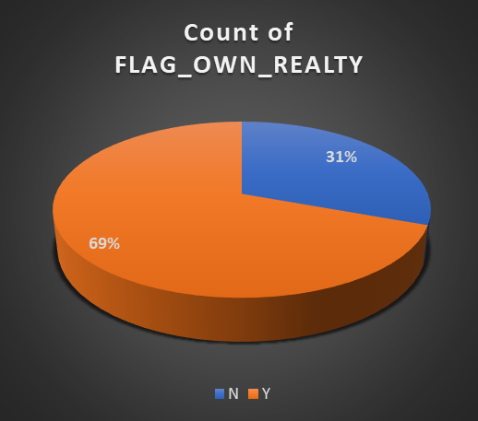
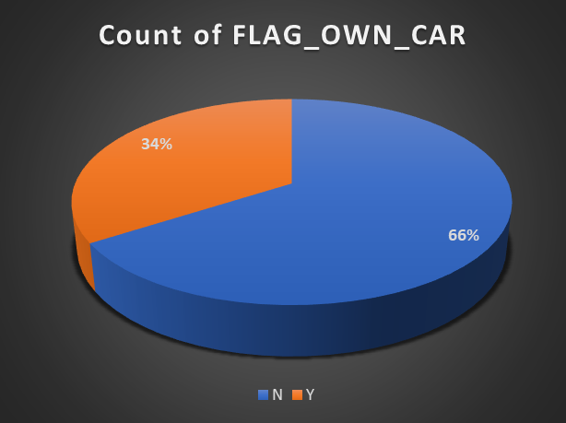
UNIVARIATE ANALYSIS

Slide 21
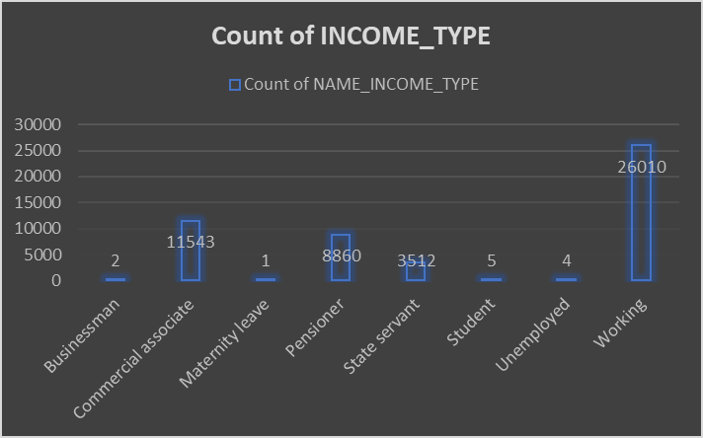
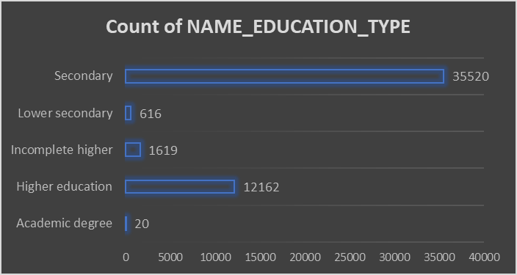
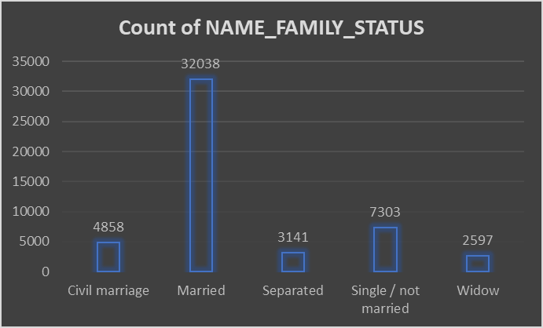
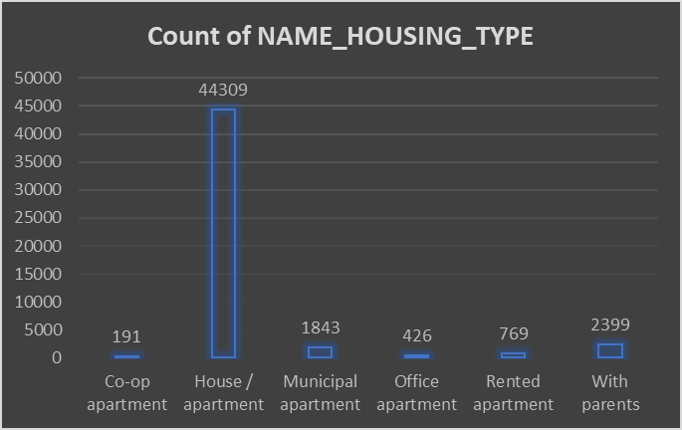

Slide 22
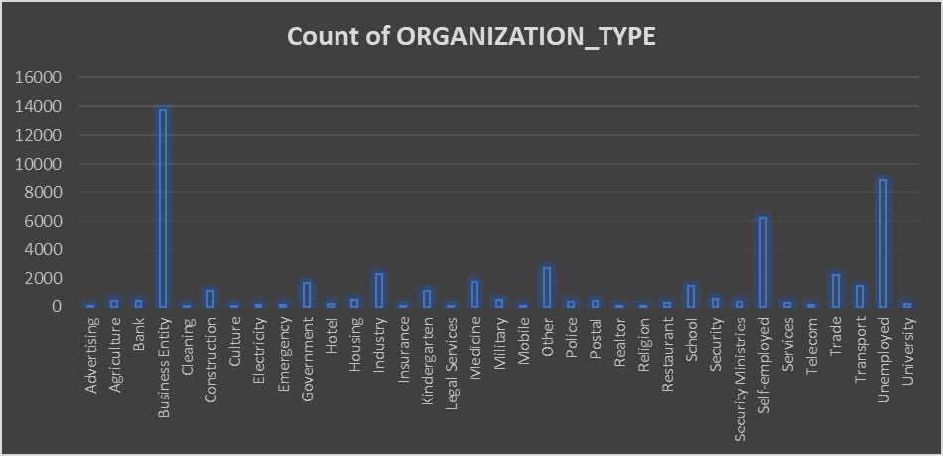
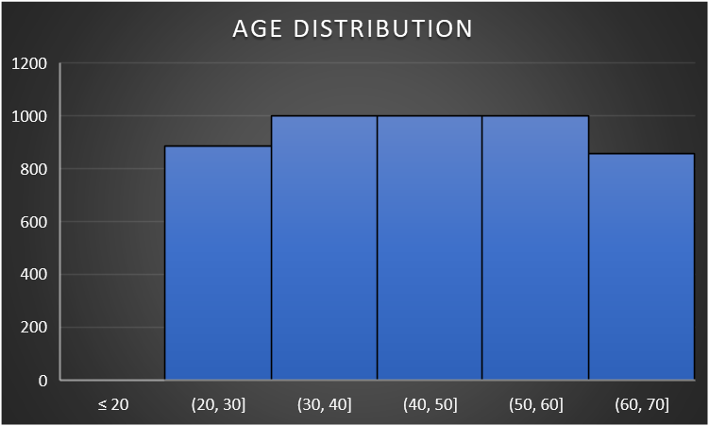
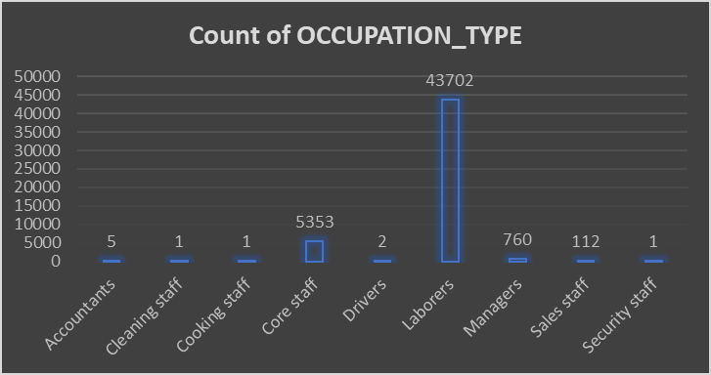
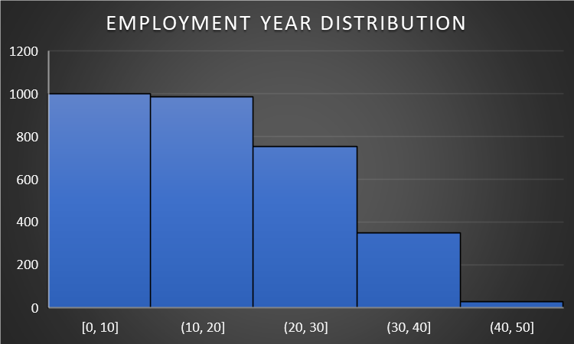

Slide 23
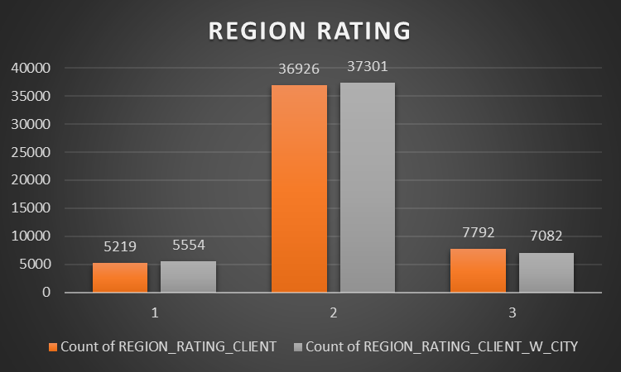
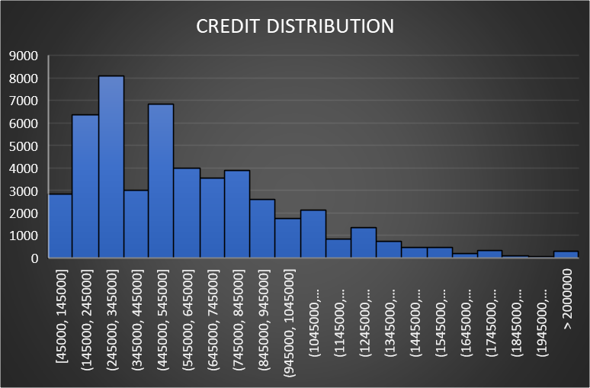
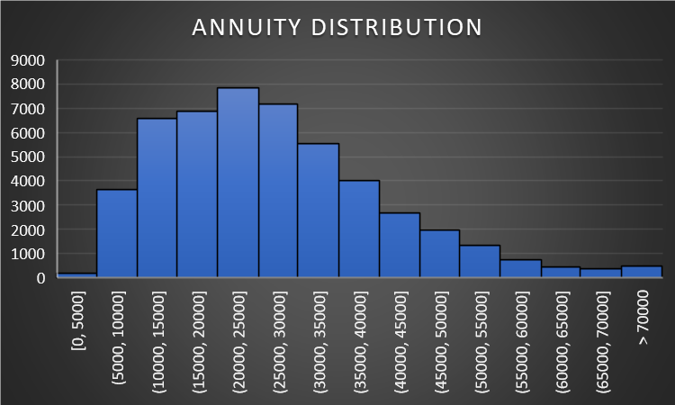
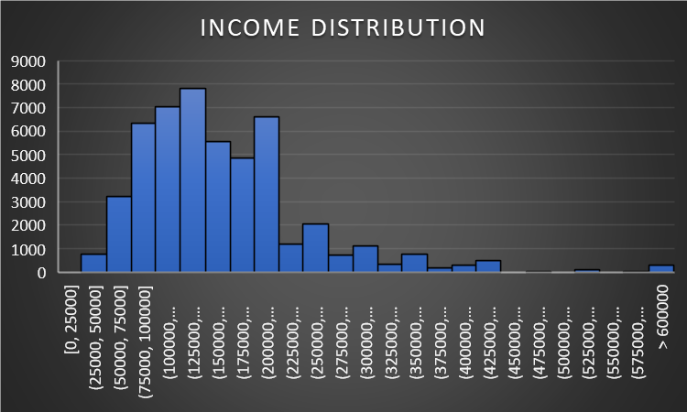

Slide 24
Insights
The dataset reveals a significant skew towards cash loans, which make up 91% of the contracts, compared to 9% for revolving loans. There is also a notable gender imbalance, with females representing 66% of the data and males 34%. Family sizes vary widely, with the largest group consisting of single applicants, while other groups have fewer than 2,000 applicants. Additionally, the number of children per applicant shows that the majority have no children (34,354), but there are over 4,000 applicants with eight children, indicating a substantial presence of large families. However, the no. of applicants with more than 8 children drops significantly.
Most applicants, under 60%, have a house/apartment or a car to their names. However approximately 30-35% applicants don’t have either.
The majority of loan applicants are Working Individuals with slightly over 26,000 applications. This suggests that working individuals are the most active in seeking loans, possibly due to their regular income and financial stability. Commercial associates, with a count of 11543 was the second largest group. 8860 applicants were pensioners possibly seeking loans for retirement-related expenses. 2,985 state servants also applied for loans, showing that government employees are also a key demographic.

Slide 25
The most applicants, with 21,831 count have finished secondary school. A significant portion of applicants have higher education, which might correlate with higher income levels and better loan eligibility. The least common, with only 355 counts, indicating that Individuals with lower secondary education are less likely to apply for loans indicated by only 355 application count.
Most applicants are married with significantly higher applications than others possibly indicating a need for family-related financial support. Widows, divorcees and civil married people have least number of applications. Single individuals also tend to take loans.
An overwhelmingly high count, suggesting that most applicants own or live in houses or apartments, which might be a factor in loan approval. Other categories (with parents, municipal apartment, rented apartment, office apartment) have much lower counts.

Slide 26
The diversity in organization types and occupations suggests a broad market for loan services, but with clear hotspots in certain demographics, with people from business entities having the highest number of applicants.
This is followed by unemployed and self-employed people. This may be due to self-employed people being freelancers or owning small businesses and needing money to fund their business. Also, unemployed people may need a loan if they want to put themselves through expensive colleges to upskill themselves. According to the occupation type chart, labourers are significantly more likely to file for loans more than any other occupation type, followed by core staff.
Middle-aged individuals (30-60) are the most likely to apply for loans. The lower counts in the 20-30 and 60-70 age groups indicate that younger and older individuals are less likely to seek loans.
Individuals with 0-10 years of employment have the highest number of loan applications, which could indicate that newer employees are more likely to seek financial assistance. The counts decrease as the years of employment increase, suggesting that more experienced employees might have more stability or different financial needs.

Slide 27
The significant number of applicants in the lower income brackets highlights a potential target market for loan products. Also, the distribution shows a wide range of credit amounts, with a noticeable concentration in the lower credit ranges. This indicates that most loan applicants are seeking smaller credit amounts, which could imply a preference for manageable loan sizes or a cautious approach to borrowing.
The annuity amounts are spread across various ranges, with a higher frequency in the lower annuity brackets. This suggests that applicants are opting for lower annuity payments, possibly to ensure affordability and reduce financial strain.
The counts for REGION_RATING_CLIENT and REGION_RATING_CLIENT_W_CITY are similar, indicating that the regional ratings of clients with and without city ratings are closely aligned.

Slide 28
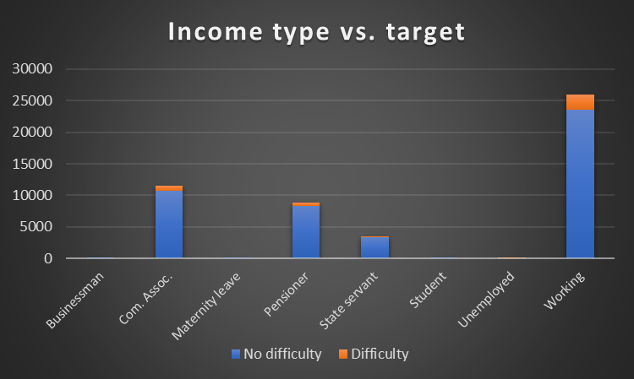
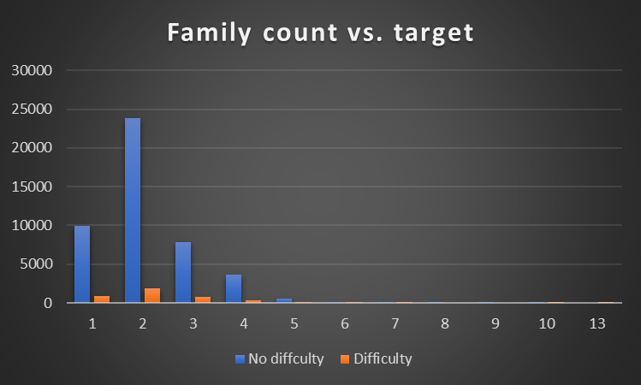
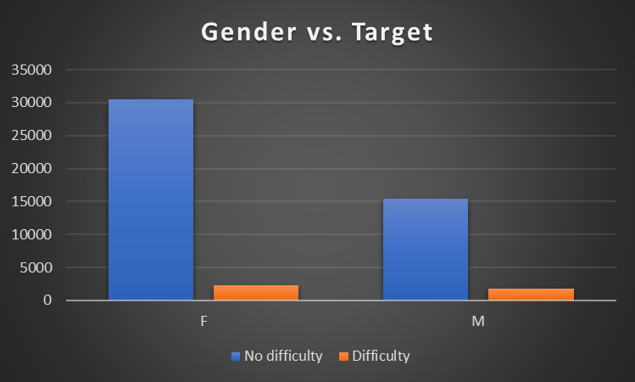
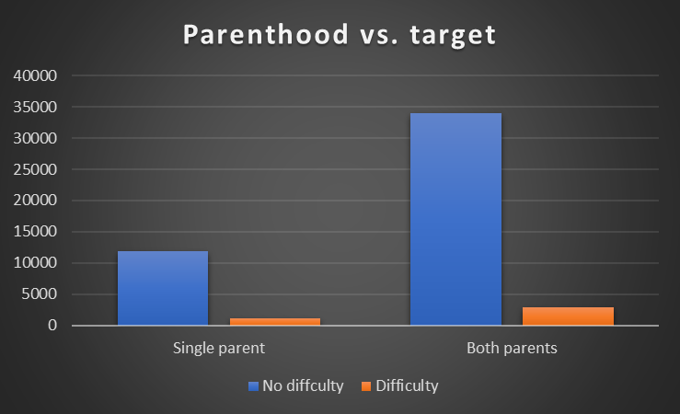
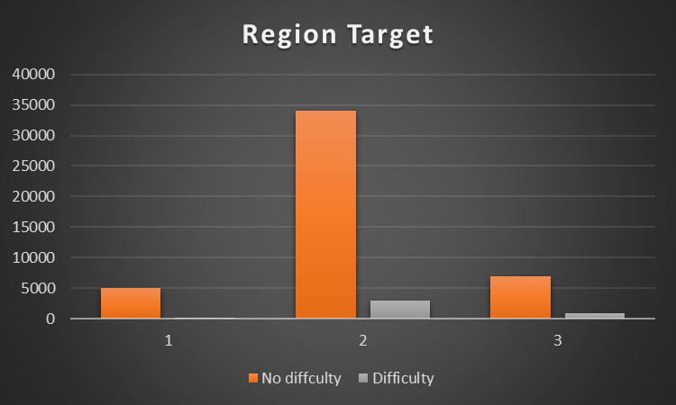
UNIVARIATE-Segmented ANALYSIS

Slide 29
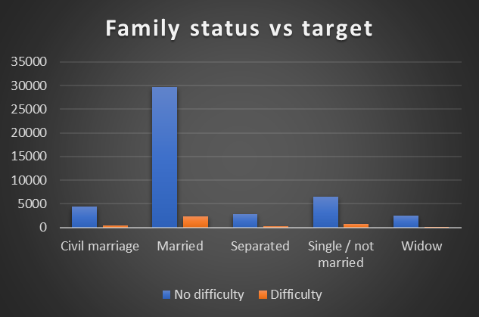
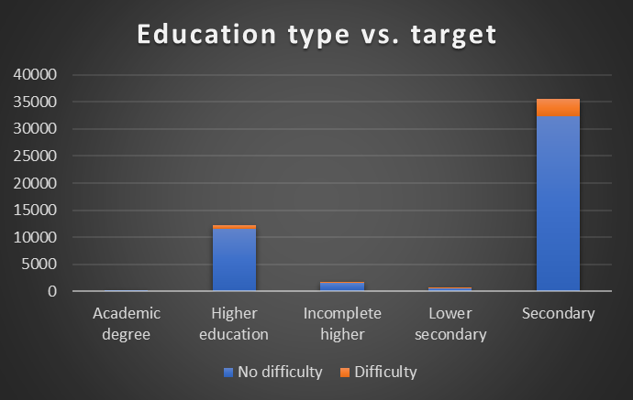
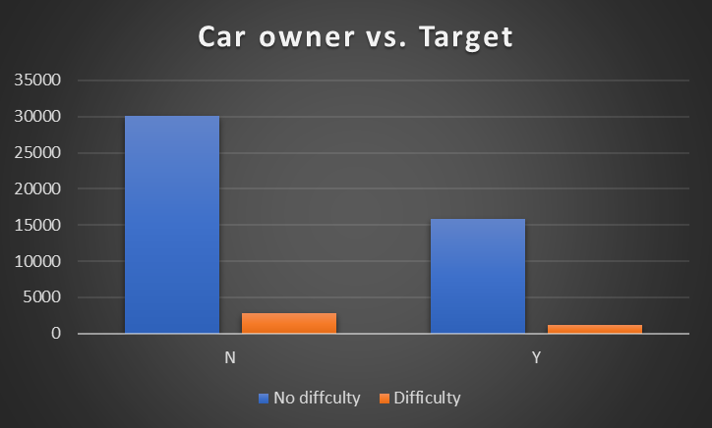
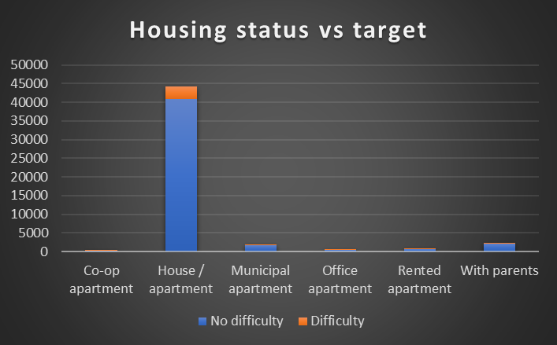
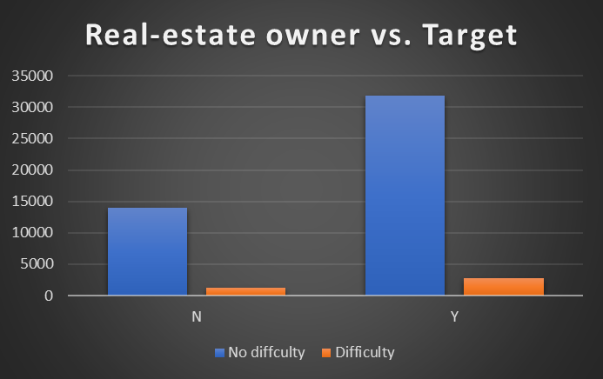

Slide 30
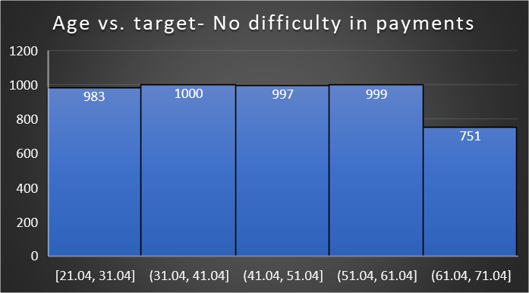
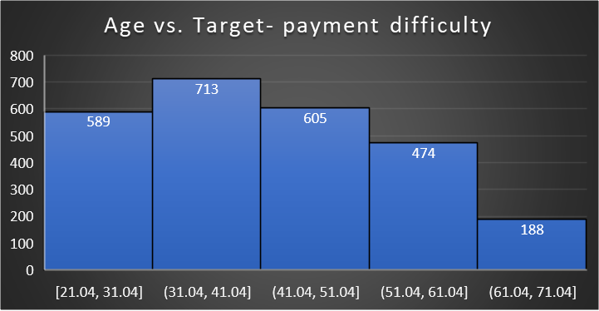
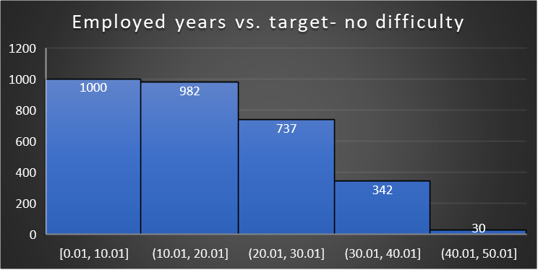
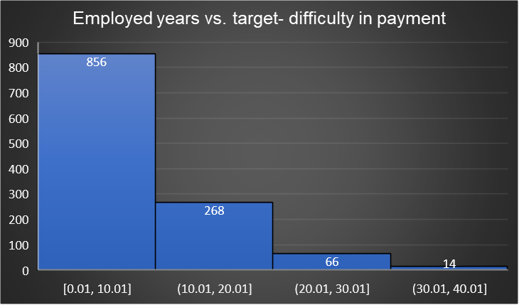

Slide 31
Insights
Working individuals have the highest number of both Non-Defaulters (no-difficulty) and Defaulter (difficulty) instances in loan payments. This suggests that while many working individuals manage their loans well, a significant portion still struggles.
Individuals with 2 family members have the highest instances of both Non-Defaulters and Defaulters. This could imply that having a small family might not significantly impact loan payment difficulties.
Larger family sizes (e.g., 6 or more members) show fewer instances overall, which might suggest either fewer loans taken or better financial management in larger families.
The number of defaulters that are females are almost the same as male-defaulters. However females also have the highest instances of non-defaulters indicating female applicants pay dues on time.
Both parents show higher numbers for both ‘Non-Defaulters and Defaulters compared to single parents. This suggests that dual-parent households might have more financial responsibilities, leading to varied loan payment experiences.

Slide 32
The chart indicates that region with rating ‘2’ has higher instances of loan payment difficulties as well as the number of applicants in general. This could be due to regional economic conditions or varying cost of living as well as higher population of the region.
Considering most applicants are married individuals, they also report the highest number of non-defaulters followed by those in civil marriages. Single/not married individuals show a higher incidence of difficulty, suggesting that marital status might influence financial stability and loan repayment capabilities.
Higher education levels might correlate with better financial management or higher income.
Individuals with secondary education have the most instances of defaulting but also the most applicants.
People living in their own house/apartment generally report no difficulty but certain scenarios may have led to defaulting.

Slide 33
Real-estate owners report fewer difficulties rates (not instances) suggesting that owning a car might be an indicator of better financial health. Non-real-estate owners almost exceed the expected level of reported difficulties, possibly due to lower income or higher financial constraints. The same can be said for car-owners.
Based on the histograms for defaulters and non-defaulters according to age, middle-aged individuals (around 30-40 years) are most likely to take loans leading to higher non-defaulters but also have higher instances of defaulting along with people in 40-50 age criteria. This could be due to increased financial responsibilities or other mid-life financial pressures around that age. It is noteworthy that individuals aged 51-70 almost having similar amount of applicants are least likely to default. This may be due to financial stability in late ages.
The group with 0.01 to 10.01 years of employment faces the highest number of payment difficulties . This suggests that those in the early stages of their careers might face more financial challenges, possibly due to lower income levels or less financial stability.

Slide 34
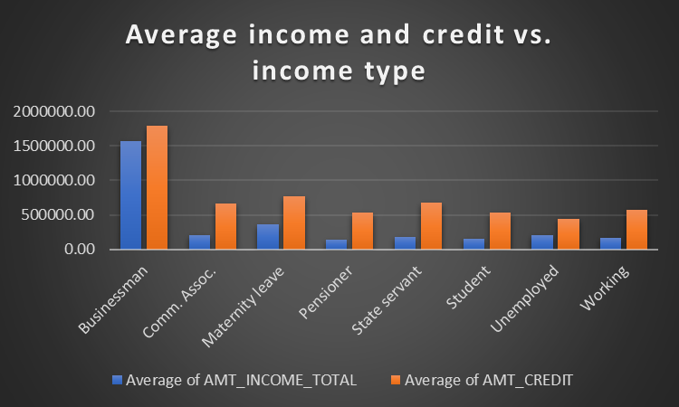
BIVARIATED Analysis
INSIGHTS
Businessman have the highest average incomes and credit amounts. This suggests they are likely to be approved for larger loans due to their higher earning potential and creditworthiness Surprisingly, individuals on maternity leave have higher average incomes than commercial associates. This could be due to various factors such as higher pre-leave salaries or specific company policies that provide substantial maternity benefits. Pensioners have moderate average incomes and credit amounts, facing some challenges in securing larger loans but generally having access to moderate loan amounts.
Student and Unemployed groups have the lowest average incomes and credit amounts, likely facing the most challenges in securing loans and qualifying for smaller loan amounts.

Slide 35
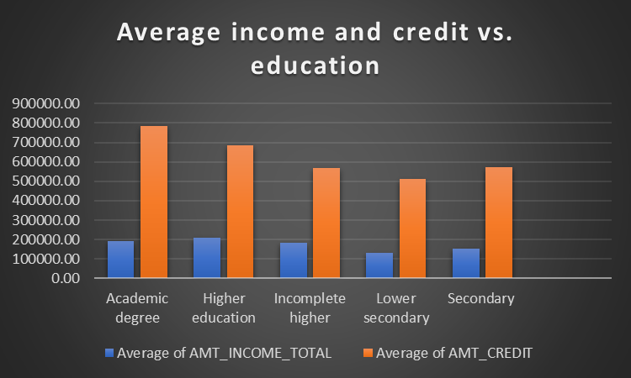
People with academic degrees and higher educations make the highest income on average. This suggests that they are more likely to be approved for larger loans due to their higher earning potential and creditworthiness. Applicants with lower secondary or secondary education have the lowest average incomes and credit amounts. This indicates that they might struggle the most with loan approvals and might only qualify for smaller loans. There seems to be a direct correlation between the level of education, average income, and the amount of credit. Higher education levels generally lead to higher incomes and larger credit amounts.

Slide 36
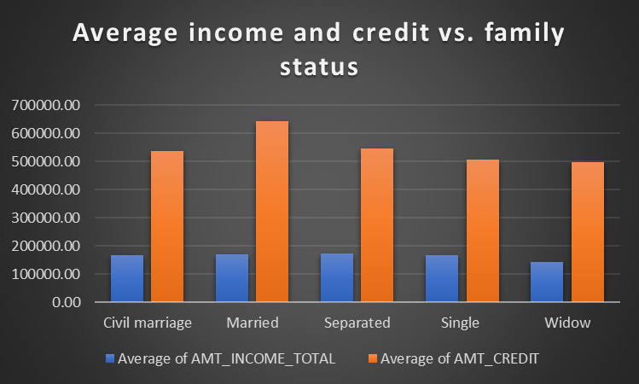
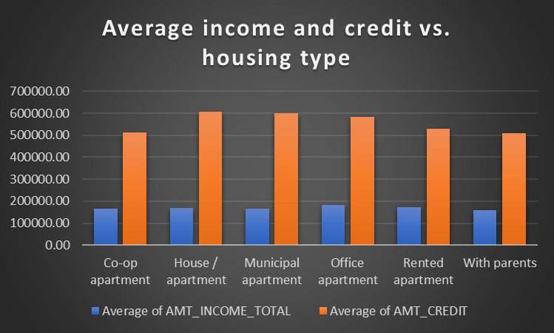
Married individuals as well as separated individuals seem to have the highest income on average but not by a large difference. However, both marred (and civil married) as well as separated individuals seem to file for higher credit amounts
People with office apartments as well as rented apartments seem to have higher incomes but not by a large margin compared to others. However, people with house/apartments, municipal apartments as well as office apartments are more likely to ask for higher loan amounts. People who live with their parents likely have a lower income and also don’t file for large credit.

Slide 37


Revolving Loans show a more consistent relationship between income and credit amount as well as annuity than Cash Loans. This could imply that lenders consider income more significantly when approving revolving loans.
The weak correlation in Cash Loans suggests that other factors might play a more crucial role in determining the credit amount for these loans. They also have a greater variability in loan sizes, more flexible repayment terms.

Slide 38

The relationship between both cash loans and revolving loans is positive but for revolving loans is much higher. The terms of revolving loans, like interest rates and payment structures, tend to have less variation compared to cash loans. The regular payment is often a fixed percentage of the outstanding balance, which creates a more direct correlation.

Slide 39
E. Identify Top Correlations for Different Scenarios
Understanding the correlation between variables and the target variable can provide insights into strong indicators of loan default.
Task: Segment the dataset based on different scenarios (e.g., clients with payment difficulties and all other cases) and identify the top correlations for each segmented data using Excel functions.

Slide 40


Non-defaulters vs. defaulters

Slide 41
INSIGHTS
The heat map represents correlations between various aspects with respect to how likely an applicant is to fall into default or non-default categories.
The greener the region is, the higher correlation there is between those two factors.
In both the charts, it can be seen that the correlation is greater between
Applicant age and gender
Applicant’s car ownership and income
Applicant’s car ownership and credit
Applicant’s car ownership and count of children
Applicant’s income and credit amount (highest correlation)
Applicant’s age with employment years
Applicant’s age and years of registration

Slide 42
OVERALL INSIGHTS

Slide 43
Majority of loan applicant’s are females but they are also likely to pay off their loans. Loan payments are not affected by single parent or dual parent households.
Applicants with higher education and higher incomes apply for higher credits.
Applicants with revolving loan applications have to pay higher annuity amounts.
Most applicants have no children but there is substantial presence of larger families. Family size doesn’t affect target.
Most applicant’s are working individuals, married and own a house. Owning real-estate and higher education with high income brackets are good indicators for loan approval.
Middle aged applicants and those that are newer in the employment age bracket are the most likely to apply for loans. Applicants nearing or crossing retirement age are less likely to seek loans but also more likely to pay them off.
Businessmen have the highest income and also go for higher credit amounts.
Most people fall into lower income brackets (125000-150000) and apply for credit amount of 250000-300000

Slide 44
RESULT:
Working with large dataset has helped me in understanding the importance of data cleaning and identifying outliers. This project also helped me in understanding the procedures behind loan approval and how to combine various factors in concluding good indicators of trustworthy applicants.
Having multiple columns for various aspects for an application helps in creating scenarios and identifying special circumstance where a loan should be approved or rejected.

